Slide 1
Thread management
2019Fall OS Project1
B05901064 林承德
2019.10.28

Slide 2
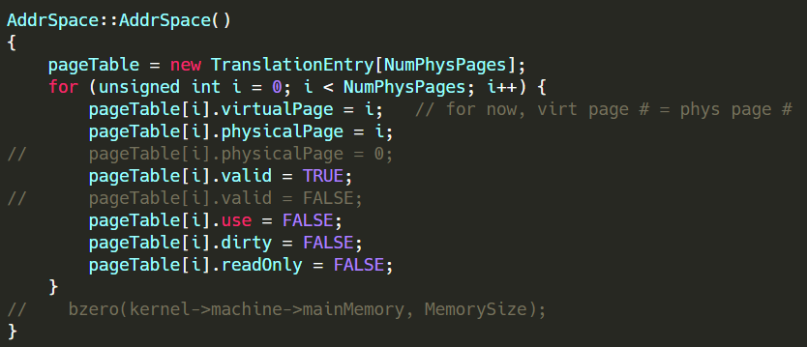
Problem
Incorrect AddrSpace
Allocate all physical pages to all processes.
Access main memory by virtual address

Slide 3
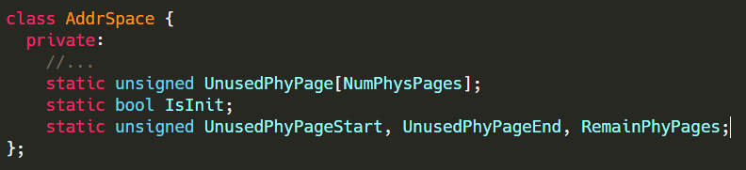
Plan
Static Circular FIFO Queue in AddrSpace
Store the page number of unused physical pages
Static : shared by all processes
FIFO : Use the physical page fairly
Circular : Reduce time complexity of deletion
Translate virtual address to physical address

Slide 4
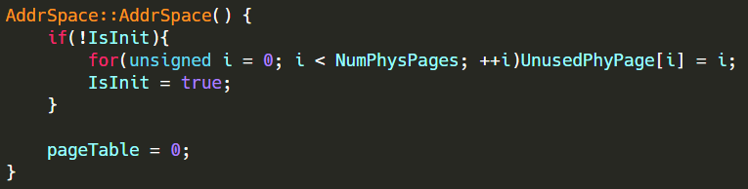
AddrSpace::AddrSpace()
Initialize the circular queue for the first time
Create the pageTable at Load() function.

Slide 5
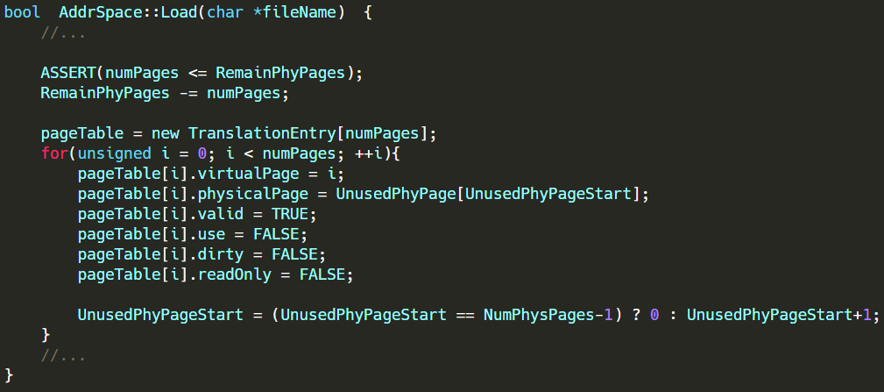
AddrSpace::Load()
Check if the request memory is greater than the remain memory
Allocate proper amount of physical pages to the process
Remove the allocated pages out of queue

Slide 6
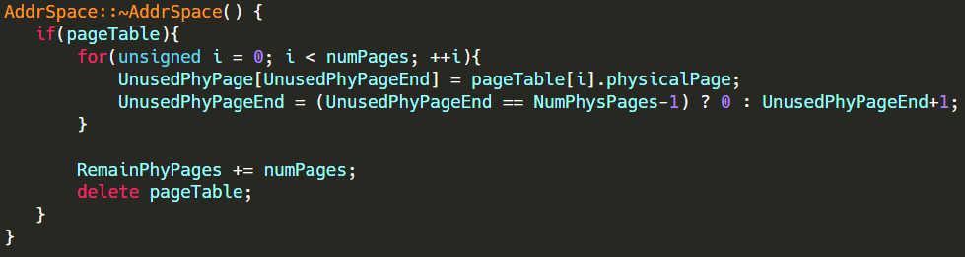
AddrSpace::~AddrSpace()
Check if the pageTable exists
Put the page number back to the queue

Slide 7
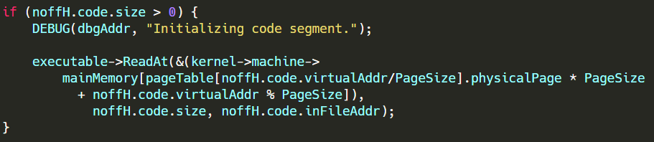
Translate the address
physpage = pageTable[virtaddr / PageSize].physicalPage
offset = virtaddr % PageSize
physaddr = physpage * PageSize + offset

Slide 8
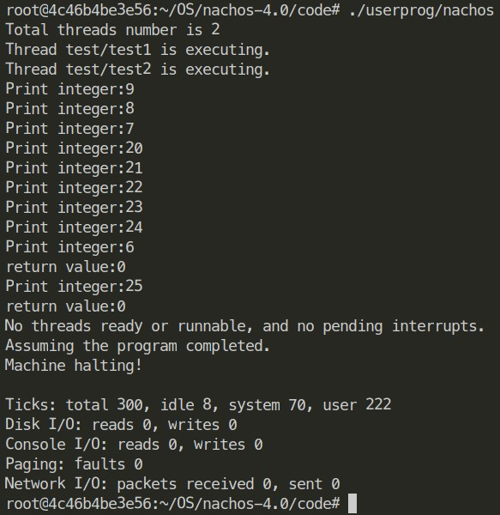
Result
Page of test1 : 11
Page of test2 : 11
Total : 22
Physpage : 32

Slide 9
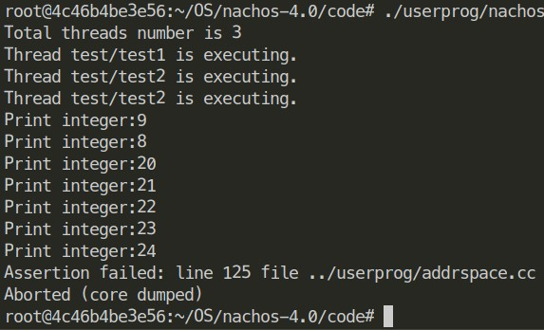
Result
Page of test1 : 11
Page of test2*2 : 11*2
Total : 33
Physpage : 32

